Slide 1
TEAM
Technocrats
Members:
Praveenkumar S
Ravindhar K
Narmadhai M
Veerammal S

Slide 2
Education
Challenge

Slide 3
Problem Statement
1. Transforming learning into Amazing e-learning Experiences.
2. Lack Of Learner Motivation And Engagement.
3. Staying Up-To-Date With Modern Tech.
4. Designing e-learning Courses For Different Generations.
5. Measurable learning outcomes.
6. Adaptive learner models to accommodate different learner needs.

Slide 4
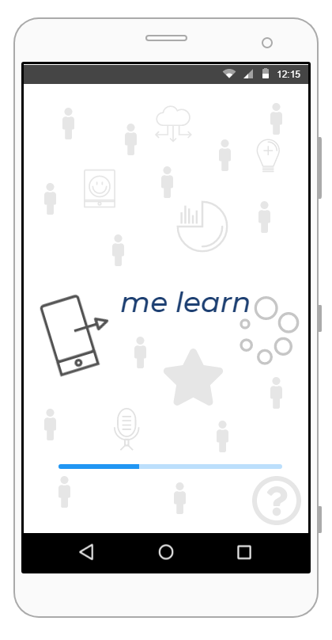
Our Solution
MeLearn App
“Application for mobile, web and desktop Build with Flutter (UI toolkit)”

Slide 5
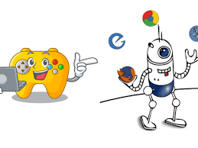
Table of content in app
Relax games
Suggested scheduled
courses
Compressed material
Score Progress Chart
Account history
Offline dictionary

Slide 6




Tools used
Flutter
Intellij Idea
Chrome web or Emulator
Technology Used
Dart Language

Slide 7

Cost of implementation and feasibility
All the tools and Technologies used for developing revivily are free, hence the cost of production and development is close to 10,000/Rs
All MeLearn app users requires is either Android device or IOS device and an internet connection which makes it affordable for everyone...

Slide 8
Wireframes
HOMEPAGE
LOGINPAGE
MY PAGE
REGISTRATION
CHANGE PASSWORD
EDIT PROFILE
CONTACT US
PAGE OF ADVISOR
PAGE OF STUDENT
ADVISOR INFORMATION
STUDENT INFORMATION

Slide 9
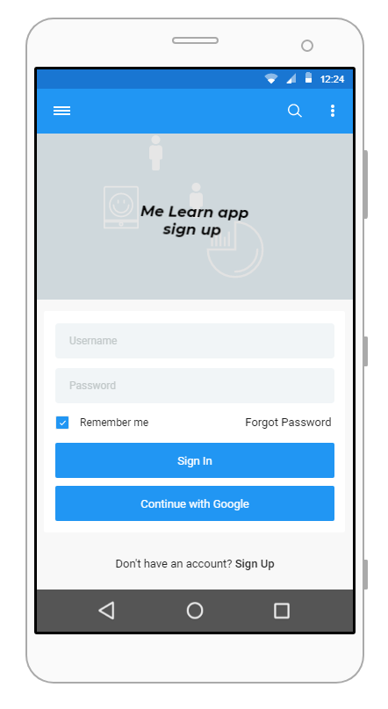
OUR APP(sample page)

Slide 10
What differs our app from others
Has more motivation content
Courses with period wise trending techs
Course overviews
Comfortable user interface
Points based on performance
Make note remember everything
Collaborative platform

Slide 11


